Slide 1
Welcome to Pack 336!

Slide 2
Getting Started
New Scouts will need to register by filling out the BSA Youth Application
Online Registration: https://beascout.scouting.org/list/?zip=07645 We should be the first listing on page, click the Apply Now button to get started.
Adults that wish to volunteer as leaders must fill out the Adult Leader Application, complete Youth Protection Training (YPT) and submit to a background check.
Council and National Dues are paid when you registered and then renewed annually on scout’s anniversary date. ($190 with Scout Life, or $175 without Scout Life via CC.)
Pack dues should be paid by the October pack meeting. We start accepting dues at the September meeting. Pack dues for 2024-2025 are $55 for new scouts.
Questions about registration, dues or fees? Call or email Luke Glasner at (201) 745-0876 or lglasner@glasner.com

Slide 3
Pack & Den Meetings
Monthly Meetings for Pack and Den - Lions and Tiger Scouts should have their parent or guardian attend meetings with them. Parents of wolf scouts and above are requested to stay for the opening announcements of pack meetings. At least one parent or guardian should attend overnight with their scout.
Pack Meetings are once a month, typically 3rd Thursday at 7:00 in Montvale Community Center. See pack calendar for dates: https://montvalecubscouts.org/pack-336-events-calendar/
Den leaders will set den meeting dates and typically meet 1-2x monthly.
Our pack holds several pack-wide events, here’s a few for the upcoming year.
Fall Family Camp Out (Oct) – We camp out Friday evening to Sunday with Troop 334 running scout skill stations and Saturday camp fire.
Bowl-A-Thon (Dec) – have a great time bowling and raise money for our pack at Montvale Lanes.
Pinewood Derby (Jan) – Scouts receive their car kits at the December meeting/holiday party. They build their cars (with parent’s help) and we race them at the Pinewood Derby in January.
Klondike Derby (Jan) – Open to Webelos/AOL scouts. Our AOL team won 3rd place district wide and our Webelos won 3rd fastest sled in 2024.
Blue & Gold Dinner (Feb) – Celebrate the anniversary of scouting and our volunteers. Arrow of Light and bridging ceremonies will likely move April due to expanded requirements.
Battleship Overnight (Mar) – Back for 2025! We’re planning on having an overnight at a real battleship.
Spring Camp Out (May/June) – We camp out Friday evening to Sunday morning as pack.

Slide 4
Communications & Contacts
Here’s a list of the main contacts for each den:
Be sure to add newsletter@montvalecubscouts.org to your address book to ensure delivery of pack emails with announcements about meeting dates, events and other info for scouts. Not getting pack emails? Contact CM Luke Glasner at lglasner@glasner.com to be added.

Slide 5
Uniforms & Handbooks
Cub Scouts should wear their uniforms to Den and Pack Meetings, as well as other official scouting events.
Lion Scouts should wear their lions T-shirt neckerchief, and hat; optional belt to display belt loops. Lions may also wear the regular cubs uniform.
Tigers to Webelos wear their uniform shirt, neckerchief, hat, scout belt (belt loops will be added as earned) and any blue pants or shorts depending on weather. For webelos colors ribbon for adventure pins.
Arrow of Light Candidates wear Scouts, America style uniform, which includes Tan shirt with patches and colors ribbon for adventure pins, green pants, scout belt (may wear belt loops), may continue to wear Webelos neckerchief, and hat.
Scouts should also bring their handbook for their rank to den meetings to get badge requirements signed off and use for activities.
You can get uniforms & handbooks at:
Scout Shop located in the district offices 25 Ramapo Valley Rd, Oakland, NJ 07436. You can also order supplies online: https://www.scoutshop.org/
Camp Alpine Trading Post has a full scout shop with good prices. Located at 441 Rte 9W, Alpine, NJ 07620 (under 20 minutes from Montvale).
Ramsey Outdoor Store on 17S has limited selection but does has shirts and some patches.
Handbooks – we purchased enough of the new 2024 advancement rules for the full pack. Handbooks are free with dues for all new scouts.

Slide 6
Uniforms – Badge and Award Placements
For Lions and above, any blue pants or shorts works, doesn’t have to be the official one.
Lions can wear the Lions T-Shirt or blue scout shirt. All wear a rank based or general cub scout hat and neckerchief.
For the belt, the webbing is cut to fit, leave a few extra inches when you cut, so it can grow with your scout.

Slide 7
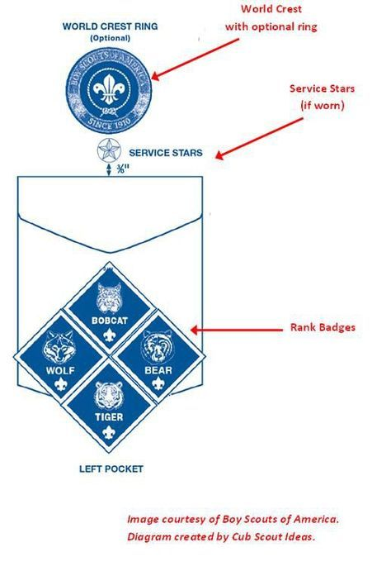
Uniforms – Badge and Award Placements
All adventure loops, ranks and other earned awards are covered by pack dues.
US Flag comes on shirt.
You buy world crest and pack numbers (336 – red)
Left Pocket
Ranks given by pack as earned
Lions Rank badge replaces Bobcat as of June 2024
Journey to Excellence Award provided by pack if earned.

Slide 8
Webelos & AOL Uniforms
Webelos continue to wear their blue shirt as of June, 2024 under the new advancement rules.
Patch placement stays the same as previous year below.

Slide 9
Badges
You will need to purchase the world crest and ring, council shoulder patch and pack numbers (336) for your scout’s uniform. The US Flag normally comes on the shirt.
These are the assigned Den numbers for 2024-2025 school year. Scout dens advance in August to the new rank year.
Den #1 for Lions (Kindergarten)
Den #4 for Tigers (1st Grade)
Den #5 for Wolves(2nd Grade)
Den #6 for Bears (3rd Grade)
Den #2 for Webelos (4th Grade)
Den #3 for Arrow of Light (5th Grade)
We will provide the Rank (left pocket)and Activity (right pocket) badges throughout the year as they are earned. Some den leaders provide their den number patches.
You can purchase shirts with badges attached at Scout Shop or use Badge Magic for a quick way to add patches without sewing. Badge magic is available at scout shop and on Amazon at: https://www.amazon.com/Badge-Magic-Freestyle-Adhesive-2-Pack/dp/B00MHZ8BBQ/ref=sr_1_4?crid=2RMP9WKOHXXDM&keywords=badge+magic&qid=1570302177&sprefix=badge+madic%2Caps%2C134&sr=8-4

Slide 10
Resources & Links
Pack 336 website: https://www.montvalecubscouts.org
Northern New Jersey Council Site: https://www.nnjbsa.org/
Three Rivers District Page: http://www.nnjbsa.org/OpenRosters/View_Homepage.aspx?orgkey=944
My.Scouting.org – all online training and additional resources provided by the BSA can be found here.
Create your account at: https://my.scouting.org/create-account
All leaders are required to take Youth Protection Training (YPT) which is done online at My.Scouting.org. (~75 minutes)
I encourage all Lion & Tiger parents to take it regardless of whether you wish to volunteer as a leader.
Scoutbook - https://scoutbook.scouting.org/ is also available as an app for both iPhone and Android devices. Scoutbook allows parents to see their scouts advancements and connect to their den leaders. Den leaders can also use Scoutbook to send text and email messages. Contact info in scout book is used for council’s annual renewal.

Slide 11
2024 Changes: Ranks, Activities and Awards
Lions work on their Lions adventures (Lions now have belt loops) to earn their Lions Badge.
As of 2024, Bobcat is no longer a rank and has moved to the first adventure every scout earns for their rank. Scouts typically earn one rank each grade. All ranks now have six required adventures and two electives. Scouts can earn as many electives as they like and I believe there still are awards if a scout earns all of them.
Many of the previous special awards our pack earned have moved to belt loops such as Cyber Chip, Shooting Sports, Pack Summertime Award. Religious awards remain unchanged; NOVA Awards are still recognized by our council. We have Nova trained leader in the pack.
Webelos and Arrow of Light (AOL) Candidates earn adventure pins that go on the webelos colors (ribbon) worn on their shoulder. Electives have been split between the two and now Arrow of Light has 8 adventures, instead of 5 as years past.
Cub Scouts are encouraged to do their best on adventure requirements, they don’t have to cover every single requirement to earn it. Many of the adventures can now be earned across levels so scouts can earn them at pack activities as well as den activities.

Slide 12
New 2024 Ranks and Adventure Loops

Slide 13
How we keep your children safe
Two Deep Rule: The two deep rule states that no individual scout should ever be alone with a leader without another adult leader to witness that interaction. The only exception is if that leader is also the scout’s parent acting as a parent.
All communications from us or any official BSA communication MUST have at least 2 leaders/adults copied on that communication.

Slide 16
The Scout Law
Meaning of Scout Law - A Scout is:
TRUSTWORTHY. Tell the truth and keep promises. People can depend on you.
LOYAL. Show that you care about your family, friends, fellow scouts/scout leaders, school, and country.
HELPFUL. Volunteer to help others without expecting a reward.
FRIENDLY. Be a friend to everyone, even people who are very different from you.
COURTEOUS. Be polite to everyone and always use good manners.
KIND. Treat others as you want to be treated. Never harm or kill any living thing without good reason.
OBEDIENT. Follow the rules of your family, school, and pack. Obey the laws of your community and country.
CHEERFUL. Look for the bright side of life. Cheerfully do tasks that come your way. Try to help others be happy.
THRIFTY. Work to pay your own way. Try not to be wasteful. Use time, food, supplies, and natural resources wisely.
BRAVE. Face difficult situations even when you feel afraid. Do what you think is right despite what others might be doing or saying.
CLEAN. Keep your body and mind fit. Help keep your home and community clean.
REVERENT. Be reverent toward God. Be faithful in your religious duties. Respect the beliefs of others.

